Slide 1


Slide 2


NETAJI SUBHAS INSTITUTE OF TECHNOLOGY
BIHTA • DEPARTMENT OF COMPUTER SCIENCE & ENGINEERING
FUTURE OF
PRESENTED BY
Prince Kumar
JOBS & SKILLS
B.Tech • CSE • 1st Semester
Roll No. 261094
Human Value in the Age of Intelligent Machines
The Big Idea
“THE FUTURE WON’T REPLACE EVERYONE. IT WILL REWARD THOSE WHO ADAPT.”
The Engineer Of 2030
“As technology evolves, engineers must evolve beyond it.”

Slide 3
02
CONTENTS
What Human Still Do Best
01
How Jobs Are Changing
02
Where The Jobs Are Growing
The Skill That Will Matter
03
04
05
INDIA’S Opportunity
06
CONCLUSION

Slide 4
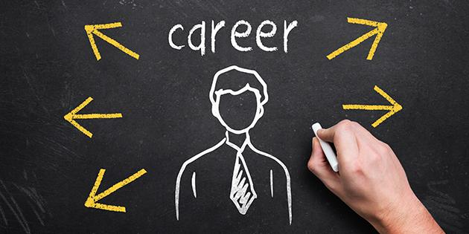

HOW JOBS ARE CHANGING
03
Tasks Are Being Automated
AI is taking over repetitive, routine and time-consuming tasks – not necessarily the entire job.
Humans Are Being Augmented
Instead of working alone, people are increasingly working with AI to analyse data, generate ideas, write, design, code and make decision faster.
Jobs Are Redefined
When AI handles certain tasks, human roles shift toward judgement, creativity, problem-solving, communication and decision-making.
The Real Shift
The future is not simply “AI replacing humans .” It is increasingly “humans who know how to work AI” replacing outdated ways of working.

Slide 5
WHAT HUMAN STILL DO BEST
04
CREATE — Divergent Thinking
Generate ideas, imagine possibilities and make unexpected connections that AI may not understand in the same human context.
JUDGE — Convergent Thinking
Evaluate possibilities, question AI’s output and choose what is actually useful, accurate and worth pursuing
ADAPT & CHALLENGE
Learn continuously, challenge assumptions and adapt when technology, situations or problems change.
LEAD & COLLABORATE
Communicate, negotiate, inspire teams and bring people together around a common goal.
“AI generates possibilities. Humans provide judgement, meaning & direction.”

Slide 6
WHERE THE JOBS ARE GROWING
05
AI & DATA
AI/ML • Big Data • Software • Cloud
AI adoption is driving demand for people who can build, deploy and work with intelligent systems.
CYBERSECURITY
Cybersecurity • AI Security • Digital Infrastructure
As businesses become more connected and AI-driven, protecting data, systems and AI infrastructure becomes increasingly critical.
HUMAN-CENTRIC WORK
Healthcare • Education • Leadership • Care
Roles requiring trust, judgement, empathy and human interaction remain highly valuable.
The fastest-growing careers are not simply “AI jobs .” They are jobs where technology and human capability work together.

Slide 7
THE SKILLS THAT WILL MATTER
06
AI & TECHNOLOGICAL FLUENCY
Use AI. Understand technology. Build with it.AI literacy + technical depth
AI tools & automation
Data & digital literacy
Cybersecurity awareness
Strong technical foundations
Why it matters: AI and big data, networks & cybersecurity, and technological literacy are among the fastest-growing skill areas toward 2030.
ANALYTICAL & CRITICAL THINKING
The valuable question is no longer only “Can you solve it?” — but “Should this be the solution?”
Analyse evidence
Verify AI outputs
Question assumptions
Make decisions under uncertainty
Why it matters: Analytical thinking remains one of the most important core skills identified by employers.

Slide 8
THE SKILLS THAT WILL MATTER
07
CREATIVITY & PROBLEM-SOLVING
AI can generate possibilities. Humans still need to define the problem worth solving.
Reframe problems
Connect unrelated ideas
Challenge existing assumptions
Turn ideas into useful solutions
Why it matters: Creative thinking is expected to rise alongside technological skills as routine work becomes increasingly automated.
ADAPTABILITY & LIFELONG LEARNING
Your most important skill may be the ability to learn the next skill.
Learn continuously
Reskill quickly
Experiment
Adapt to changing technology
Why it matters: WEF estimates that around 39% of workers' existing skill sets could be transformed or become outdated by 2030, while 59 out of every 100 workers are expected to need training or reskilling.

Slide 9
INDIA’S OPPORTUNITY
08
1.BUILD AI TALENT
India already has a strong technology and engineering base.The opportunity is to move from IT talent → AI, data, cloud & cybersecurity talent.
2.APPLY AI AT INDIA'S SCALE
India can use AI across healthcare, agriculture, finance, manufacturing, education and public services — not just build AI products.
3.MAKE THE WORKFORCE AI-READY
The biggest opportunity is not replacing workers .It is upgrading workers with AI + technical skills + human judgement.
170M
CREATION
2030 GLOBAL JOB OUTLOOK
+170M
−92M
+78M
92M
New Roles Created
Roles Displaced
Net Change
DISPLACEMENT
22% of today's formal jobs are expected to be disrupted by 2030 — because technology is only one driver. Economic shifts, demographics, geopolitics and the green transition matter too.

Slide 10
Conclusion
09
0
01
AI will transform jobs, not simply eliminate them.
02
AI + human collaboration will become the new way of working.
Critical thinking, creativity, communication and judgement will become more valuable.
03
04
Technical skills alone will not be enough.
Continuous learning will be the most important career advantage.
05

Slide 11


Happy Engineers’ Day
BUILD | AUGMENT | HUMANIZE
Under the Guidance of
Ms. Aastha Kashyap
Assistant Professor, CSE Department

